Slide 1
Credit Card Fraud
Analysis

Slide 2
State with the maximum number of frauds is California

Slide 3
Descriptive Statistics of California data
Amount Fraud Class
count 146.000000 146.0
mean 120.872123 1.0
std 243.229393 0.0
min 0.000000 1.0
25% 1.000000 1.0
50% 8.770000 1.0
75% 117.205000 1.0
max 1809.680000 1.0

Slide 4
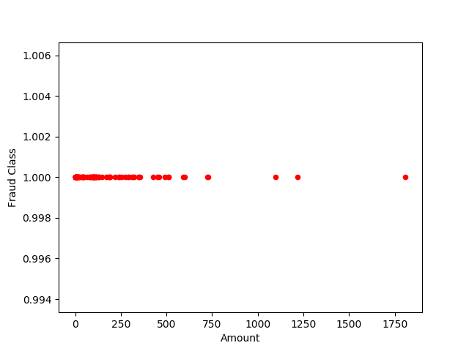
Amount and Fraud Class – Scatter Plot

Slide 5
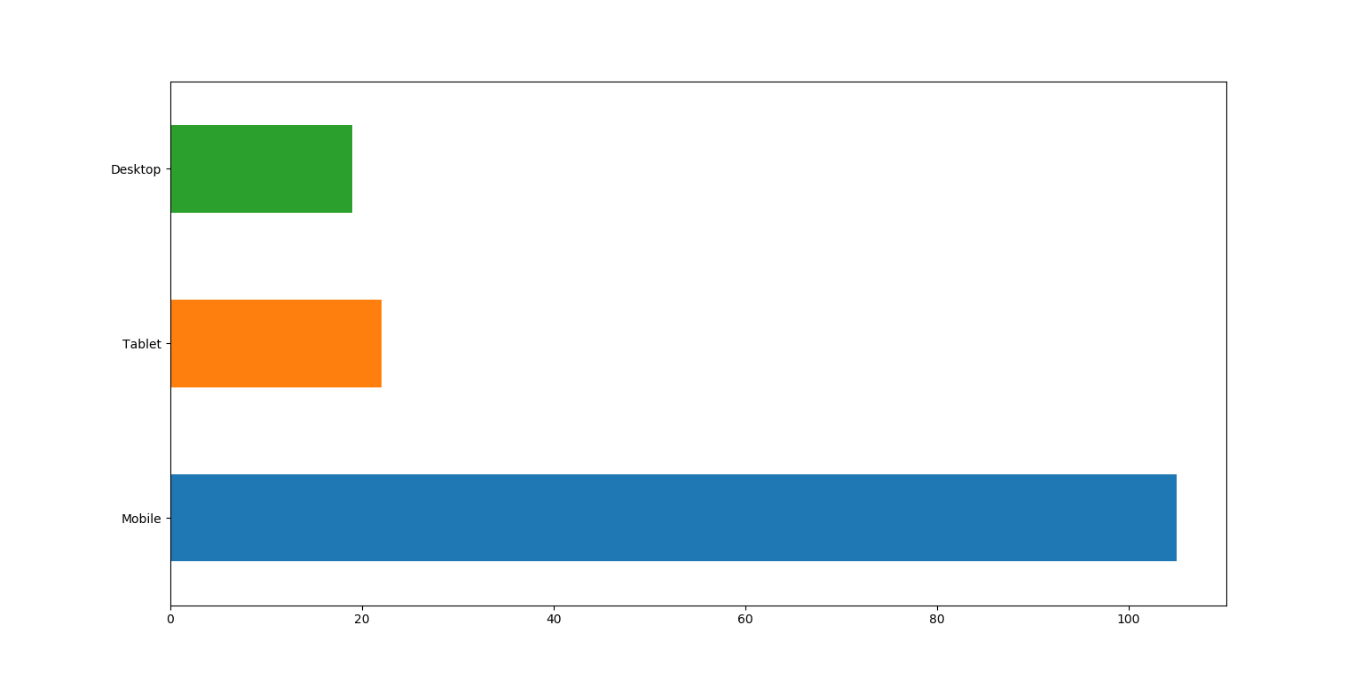
Device distribution California data

Slide 6
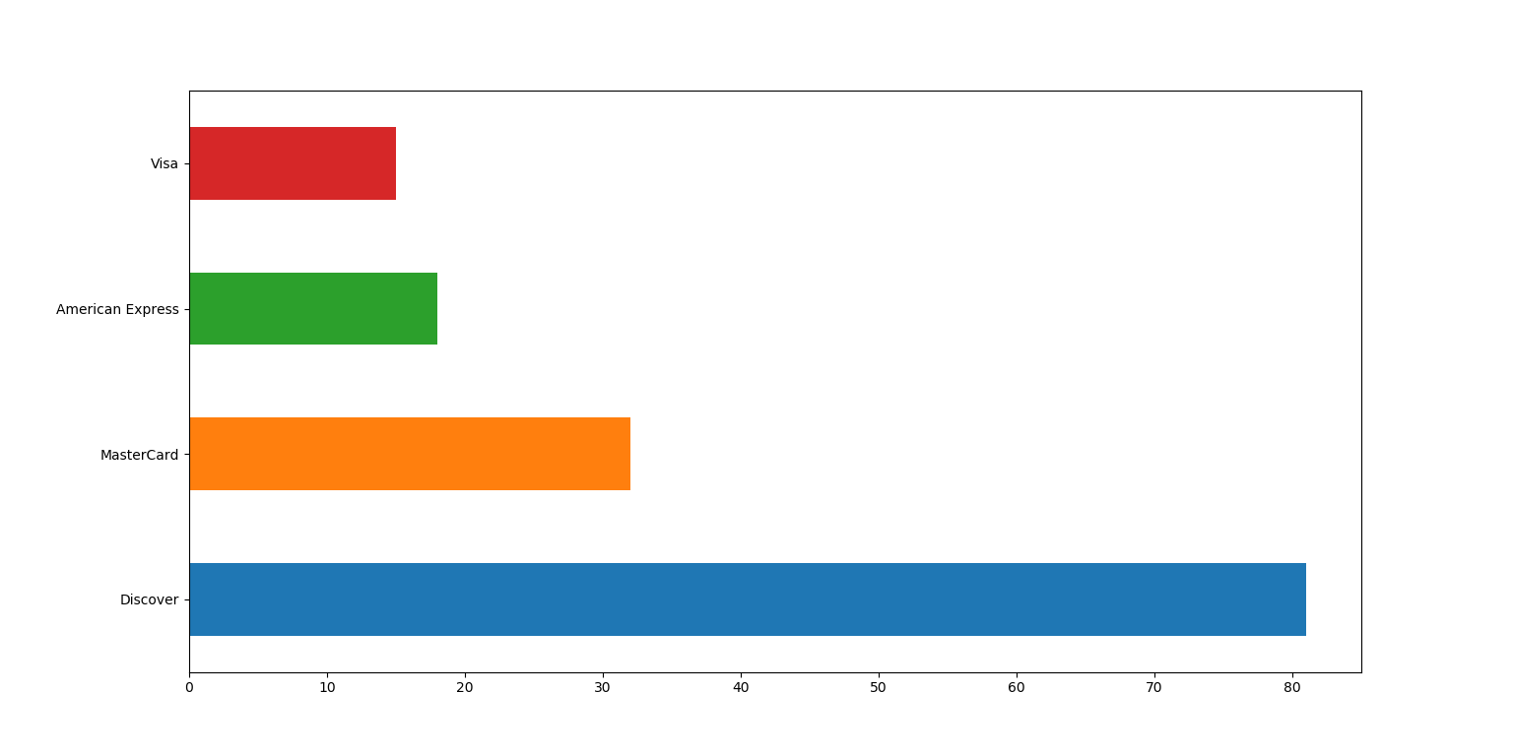
Type of credit card distribution California data

Slide 7
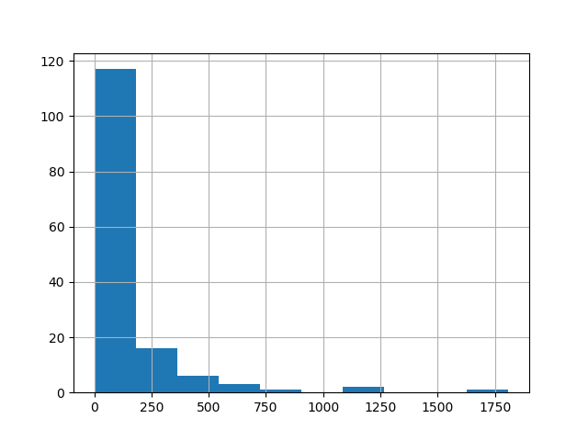
Amount distribution California data

Slide 8
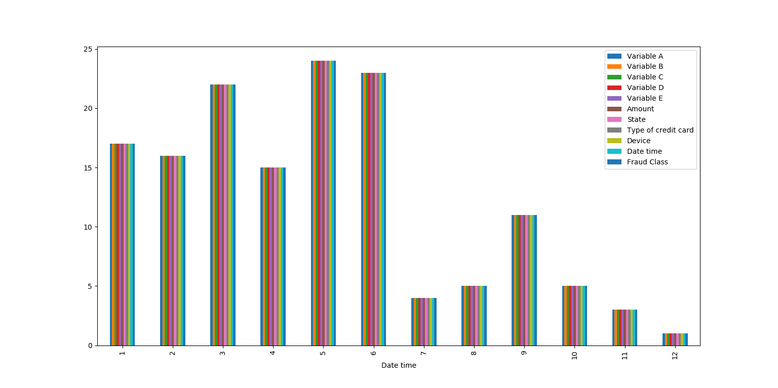
Date time distribution California data

